Slide 1



Visualizing Carbon Footprints
Across Sectors Using Power BI

Slide 2

Learning Objectives
Data Visualization Mastery : Appreciate the best practices for effectively converting raw data into useful visuals with an industry-standard tool.
Insight Generation : Gain the ability to analyze and interpret multi-dimensional environmental data trends (e.g., monthly, yearly, and sector-wise carbon emission trends).
Dashboard Development : Acquire hands-on experience in designing interactive, decision-supporting dashboards.
Business Intelligence Application : Gain expertise in utilizing BI solutions to merge data from multiple sources, perform aggregations, and deliver actionable insights.
Environmental Impact Analysis : Develop skills to evaluate carbon footprints by geographical location, sector, and over time to guide sustainable planning.
GOAL
Source :
www.freepik.com/

Slide 3
Tools and Technology used
Microsoft Power BI Desktop : Data modeling, data transformation, and visualization are predominantly done using the primary tool employed here. Interactive features of Power BI are utilized to develop interactive charts and dashboards as encountered in the project screens .
Sources of Data : The dashboard deploys carbon emissions data (measured in Megaton units) from various industries and nations spanning five years. Data integration and preparation are conducted within Power BI to provide tidy, analyzable data.
DAX (Data Analysis Expressions) : Used within Power BI to create calculated columns, measures, and KPIs for advanced analytics.
Power Query Editor : Utilized for data cleaning, transformation, and merging multiple data sources before loading into Power BI models.
Visualization Elements
Line and Bar Charts : To present trends over time (months, years) and sector-wise distributions.
Pie/Donut Charts or Distribution Charts : To offer a snapshot presentation of sector-wise or country-wise contributions to the overall carbon footprint.
Slicers/Filters : For interactive exploration of data by country, year, sector, and other variables.

Slide 4
Methodology
Data Acquisition and Preparation
Collection : Retrieved carbon footprint information for various countries, sectors, and years.
Cleaning and Transformation : Employed Power BI Query Editor to clean the data—removing discrepancies and formatting values to facilitate interpretation.
Data Modeling
Relationships : Defined relationships among different datasets (e.g., connecting country data with sector emissions).
Aggregation : Calculated key statistics such as overall emissions, mean carbon footprints, and monthly/yearly distributions.
Visualization Design
Chart Choice : Selected relevant visualizations (bar, pie, and line charts) according to the data nature and information needed.
Interactivity : Included dynamic filters and slicers for enabling users to drill down within a certain sector, year, and country.

Slide 5
Methodology
Assembly and Testing of Dashboards
Layout Arrangement : Laid out the visuals in an effective dashboard structure that is informative as well as easy to navigate.
Validation : Verified interactivity and data validity through cross-referencing of calculated metrics with the source data.
Iteration and Enhancement
Feedback Loop : Utilized user feedback (from iterative reviews and sessions) to enhance visuals and better the overall user interface for increased decision support.

Slide 6
Problem Statement:
The key challenge addressed in this project was the complexity of analyzing and presenting carbon footprint data across multiple dimensions. Major challenges included:
Fragmented Data Sets
Emission values originated from various sectors such as Domestic Aviation, Ground Transport, Industry, International Aviation, Power, and Residential, across multiple nations.
Temporal Dynamics
Five years' worth of data had to be carefully analyzed to detect long-term trends and seasonal variations.
Decision Support Requirement
Stakeholders needed an interactive and easy-to-understand dashboard to identify emission hotspots and recognize opportunities for environmental improvement.
Overall Challenge
To design a solution that could:
Aggregate and reformat large-scale emission data into actionable insights.
Display complex data in a clear and interactive visual format.
Enable end users to dynamically explore trends across various parameters.

Slide 7
Solution:
The project’s solution was the development of an interactive Power BI dashboard to visualize the carbon footprint by sector, country, and time period. Key components of the solution include:
Integration of Multi-Dimensional Data
Combined data from 14 countries, 6 sectors, and 5+ years, offering both:
Macro insights (total emissions and country-wise trends)
Micro insights (monthly patterns in specific sectors)
Dynamic and Interactive Visualizations
Users can interact with charts to filter by sector, country, or year.
Key visual components include:
Monthly Trends: Line/bar charts to show sector-wise and month-wise variations.
Yearly Distributions and Averages: Compare emissions over time and across sectors.
Sector and Country Distributions: Visual rankings and percentage contributions by sector and region.
Actionable Insights
The dashboard enables stakeholders to:
Pinpoint the most polluting sectors and regions.
Inform policy decisions and support strategic environmental planning.

Slide 8
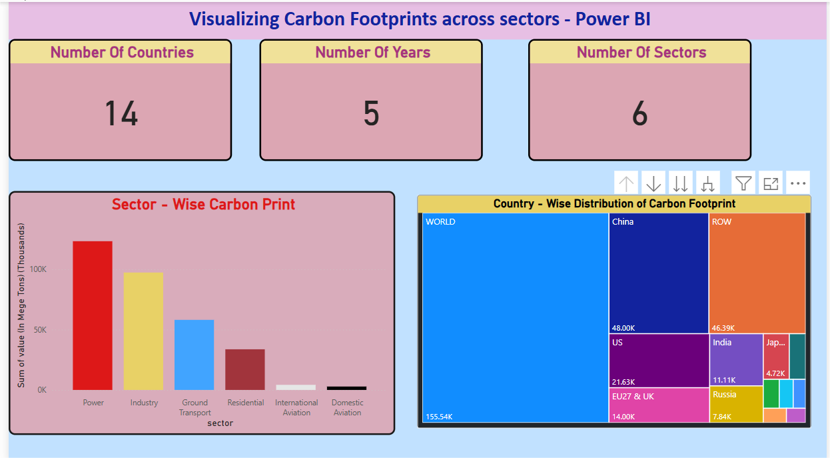
Screenshot of Output:
This Power BI dashboard intended to map carbon footprints. It contains the most important summary measures (14 nations, 5 years, 6 sectors), a bar graph showing carbon emissions by sector (with the power sector appearing as the largest contributor), and a treemap showing each nation's contribution to the overall emissions (with nations such as China, the United States, and India as the largest contributors).

Slide 9
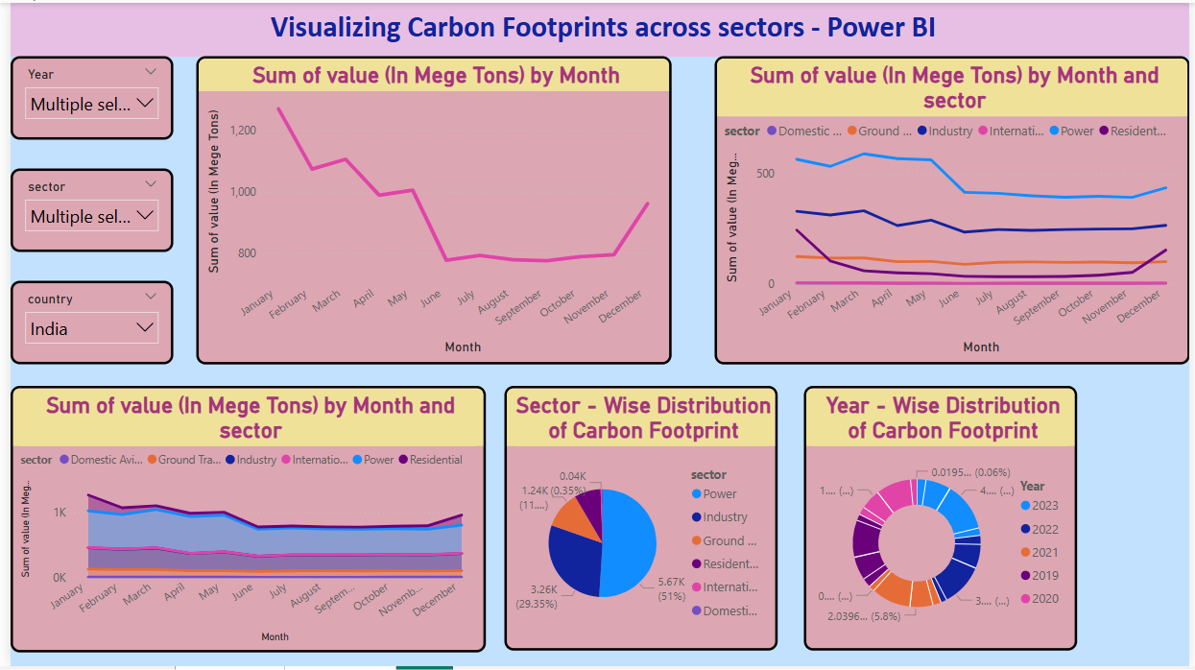
Screenshot of Output:
This Power BI dashboard illustrates monthly carbon footprints in various sectors. The top line charts indicate total emissions by month and emissions by month and sector. There's a pie chart below showing how various sectors contribute to total emissions and a donut chart indicating emissions by year. Left-hand filters enable the choice of individual years or nations (in this case, India) to narrow down the data and learn more about carbon footprint trends.

Slide 10
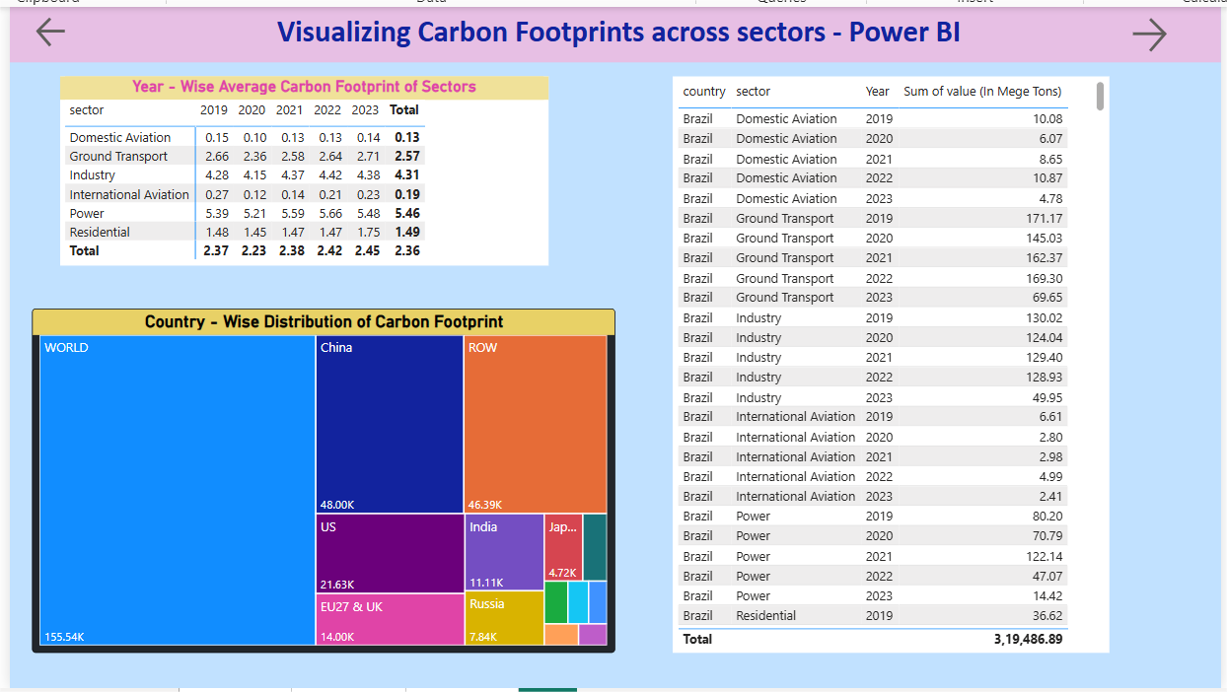
Screenshot of Output:
This Power BI dashboard indicates a segmentation of carbon footprints by industry, year, and nation. The top-left table displays the comparison of average carbon footprint amounts by industry for 2019-2023. The treemap on the bottom-left provides each nation's percentage of aggregate carbon emissions with greater blocks reflecting higher emissions. A detailed table of emissions figures by nation and industry, followed by a grand total at the bottom, are presented on the right.

Slide 11
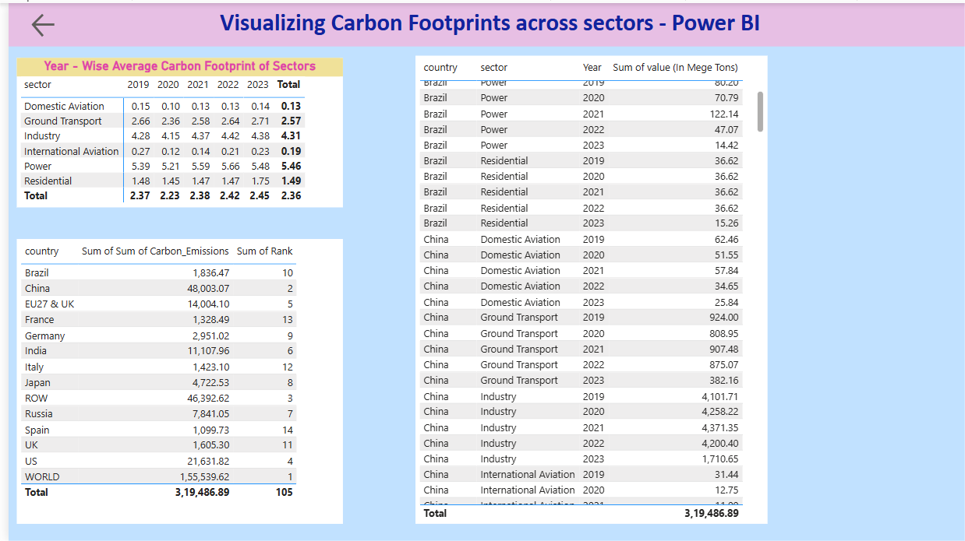
Screenshot of Output:
This Power BI dashboard emphasizes carbon emissions data in three primary tables. At the top left, the first table displays each sector's average carbon footprint year on year (2019–2023), and below it, the list of total emissions by country. The third table, on the right, offers a breakdown by country and sector with emissions values and a grand total at the bottom.

Slide 12
Conclusion:
The project effectively showcases the potential of using Microsoft Power BI to visualize intricate environmental data. Some of the key takeaways are:
Successful Data Communication
The interactive visualizations transform complex datasets into clear, comprehensible insights that facilitate informed decision-making.
Improved Analytical Capabilities
Users can dynamically explore data to identify trends and outliers across time, sectors, and geographic regions.
Facilitation of Environmental Strategy
By clearly highlighting regions with high carbon emissions, the dashboard aids policymakers and industry leaders in planning actionable steps to reduce carbon footprints.
Overall Impact
This project not only enhances proficiency in data visualization and business intelligence but also provides a strategic tool for addressing one of the world's most pressing environmental challenges.
Git-Hub Repository : https://github.com/Dharmalashiva/Carbon-Footprints.git

